Slide 1
Name: Swapnil Ghosh
Group: A2
Roll: 001911001067
TASK 8

Slide 2
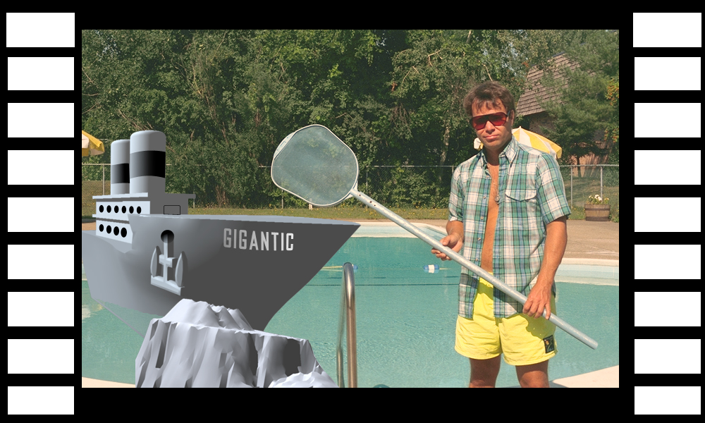
Step-1) Opened the file HISTORY.TIF in Photoshop and changed the History State to 50 .
Step-2) Changed the foreground Color to White and background Color as Black.
Step-3) Changed the canvas size to 1000 * 600 pixels.
Step-4) Using Rectangular Marquee made a small rectangular sprocket hole to upper-left and filled with white Color.
Step-5) Deselected the selection and using Rectangular Marquee draw a selection border around white
rectangle including some black border.
Step-6) Using Rectangular Marquee choose the entire left black border and filled with the new pattern created, and duplicated it on the right side and created a new Snapshot.

Slide 3
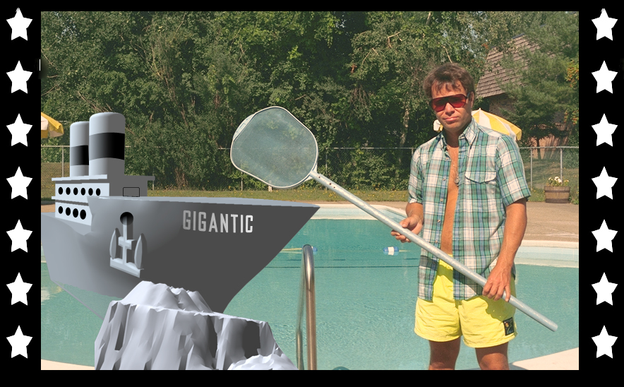
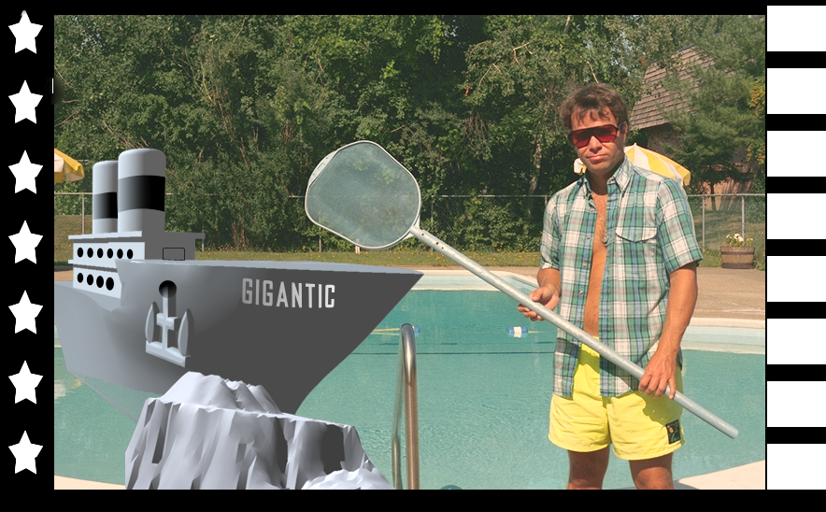
Step-7) Repeated the same process as previous and added the star border on both the side.
Step-8) And then compressed all the layer into single layer and saved it.
Step-9) Used the History panel to get back to previous snapshot.
Step-10) Filled the Right side with Rectangular Box saved pattern.

